Slide 1
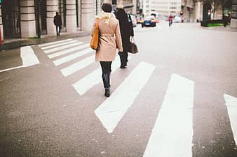
Hamilton Township Bicycle and Pedestrian Audit
May 21, 2021

Slide 2




Survey Results
78
Responses
Safety - 42%
Sidewalks - 25%
71
Comments
Bike Path - 28%
Bike Access - 18%
Roads aren’t safe or should be safer
Of those, ~40% want more or said the network was inconsistent
Of those, 30% want more lighting, 20% want to extend into town
Add bike lanes or widen shoulders
Notes:
4 main themes
Mentioning the bike path: ranging from enjoyment to usage - 28%

Slide 3
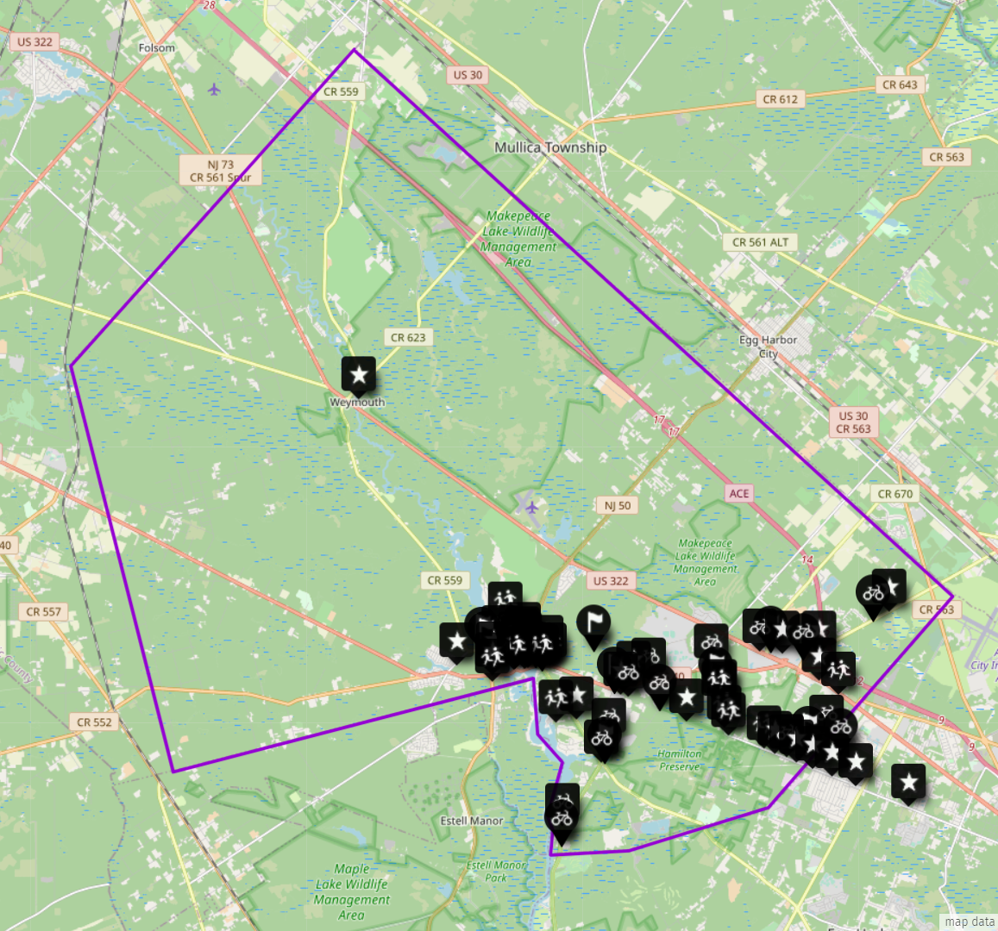
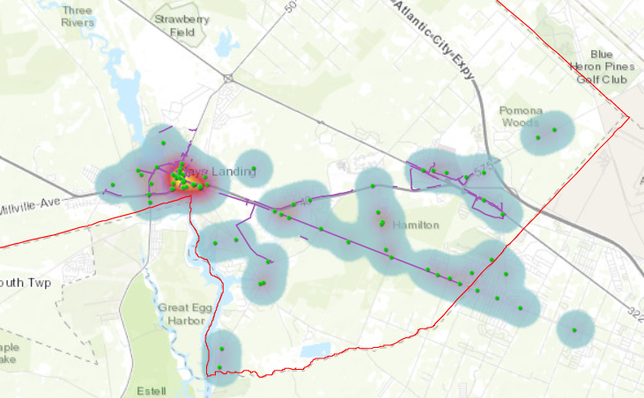
Mapping Activity
uMap
4 types of points
Notes:
General activity

Slide 4
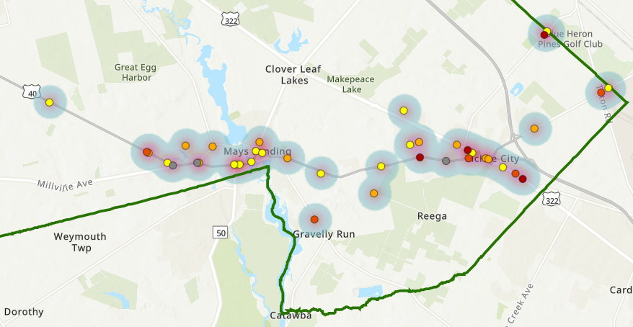
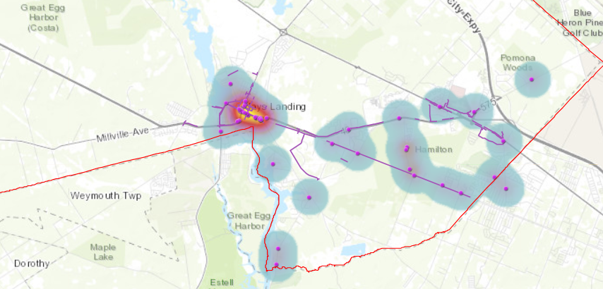
Crashes vs.
Concerns

Slide 5
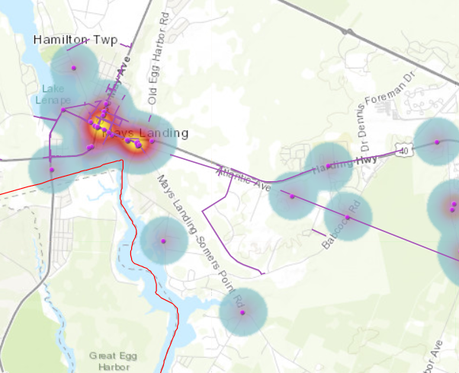
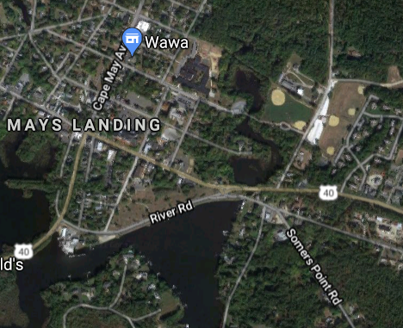
Hot Spots of Concern
Two Intersections
Notes:
2 hotspots
Bulkhead area: difficult/dangerous

Slide 6
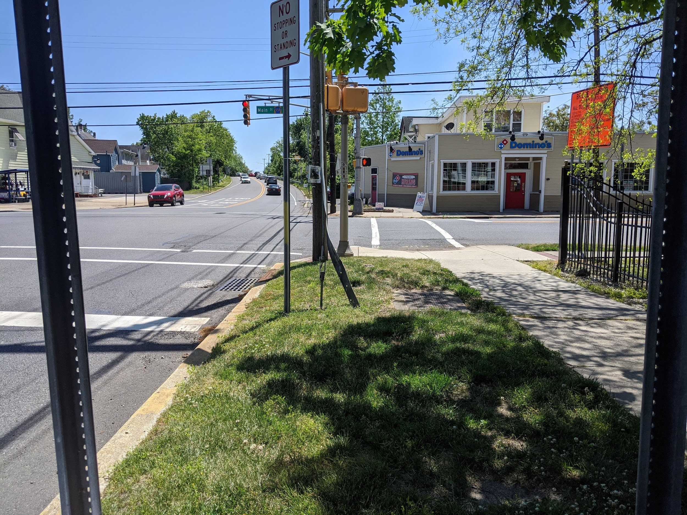
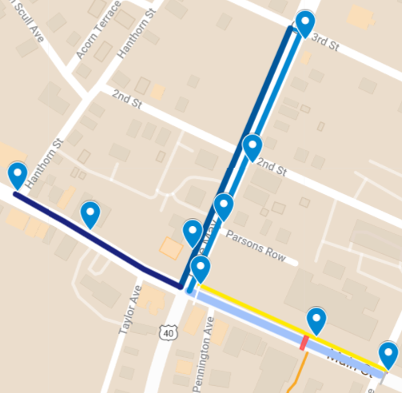
Walk Audit Results
Main St = CR 559
Cape May Ave = NJ 50

Slide 7
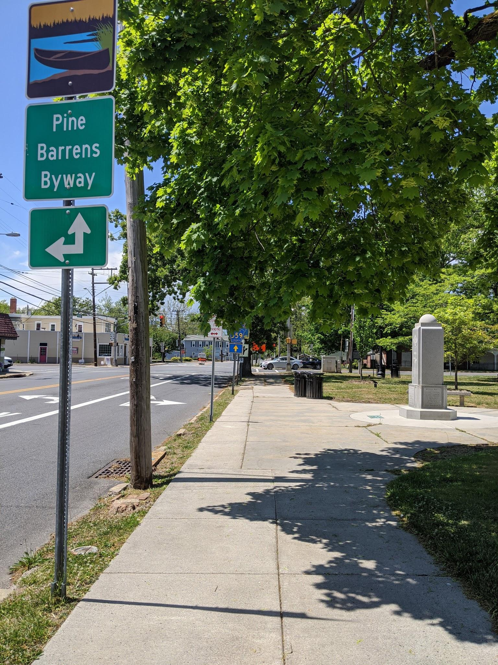
Positives
Along Main St
  Large width
  Tree-lined
  Benches
  Plenty of trash/recycling cans
Large buffers
Sidewalks in good condition

Slide 8
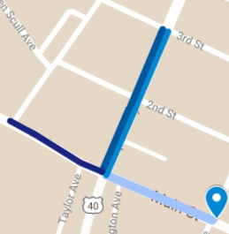
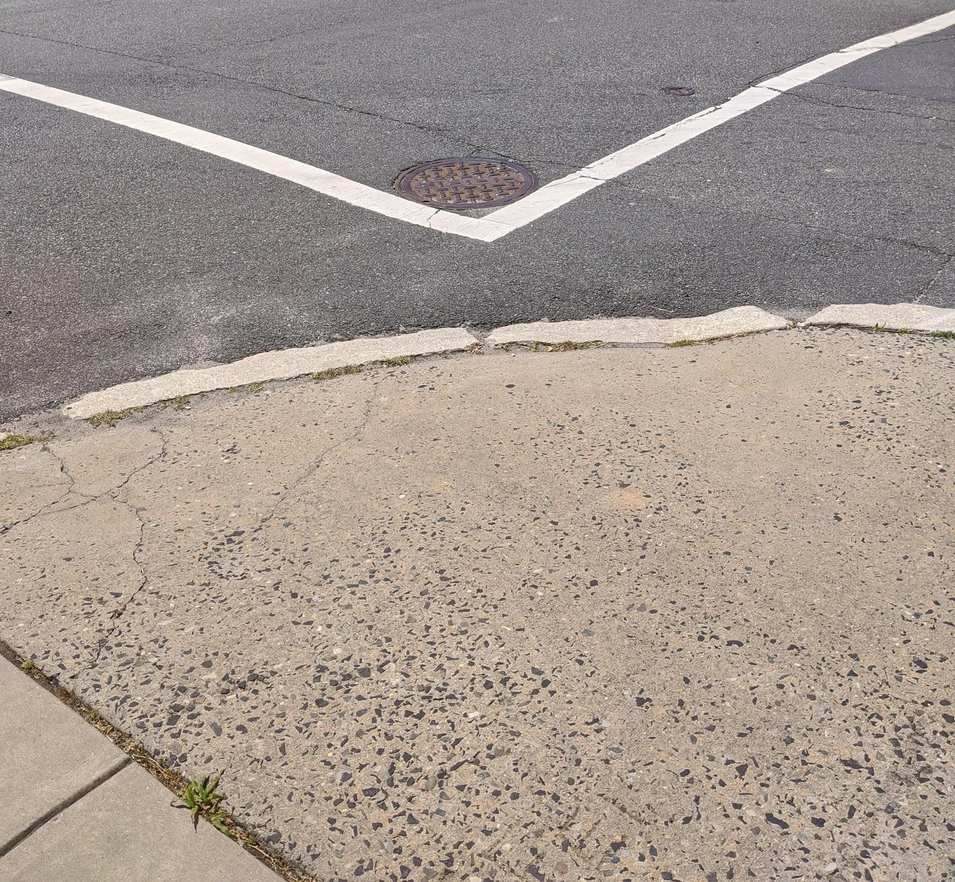
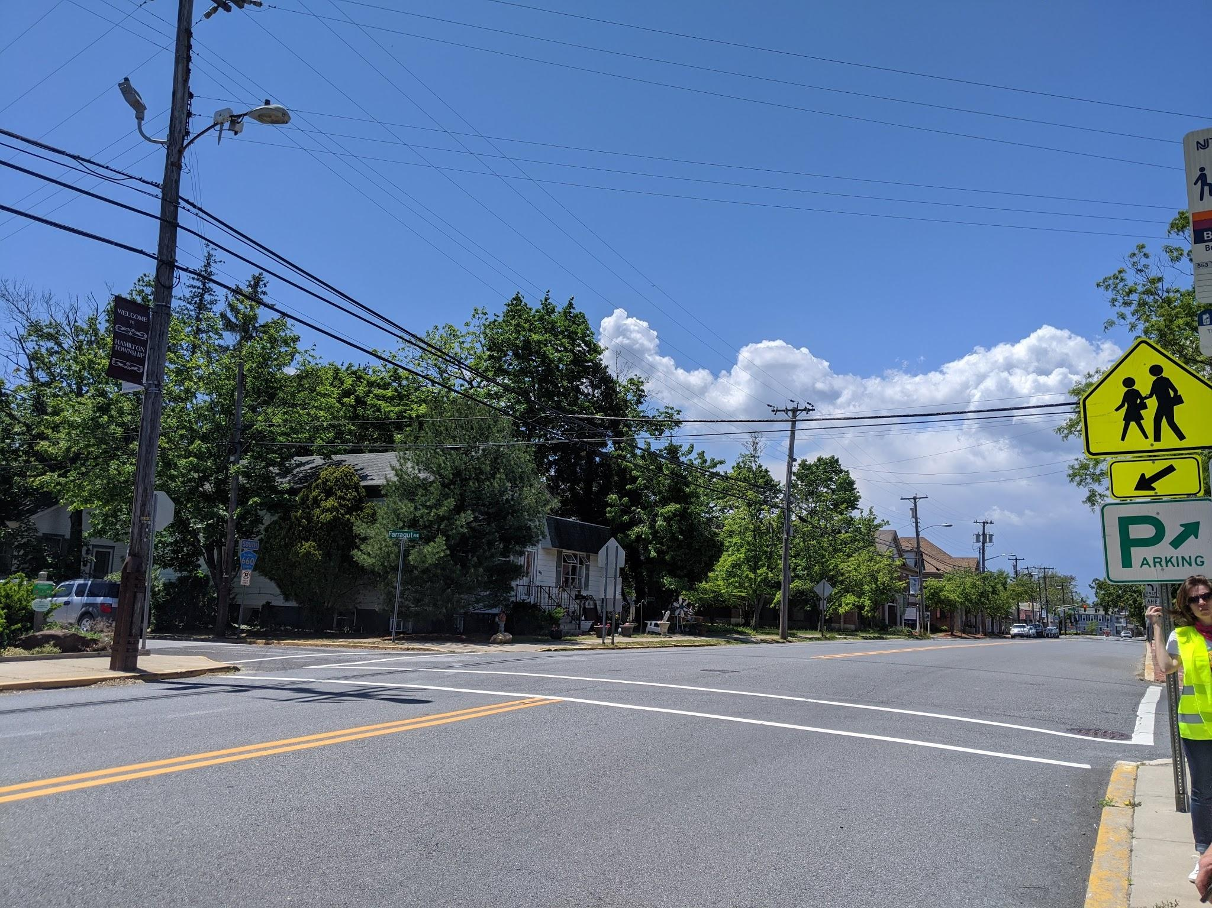
Main St & Farragut Ave
Stop 1
Existing Conditions:
High pedestrian activity: library, school, courthouse
Issues:
Curb ramps - many not ADA compliant
  Streets appear recently repaved: when to retrofit?
Feels unsafe to cross
Street very wide
Recommendations:
Higher visibility crosswalks, in-street signs, lane diet
Notes:
When does road project require retrofit?
https://streetmix.net/ln7mb/6/main-st-alt

Slide 9
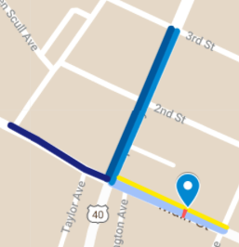
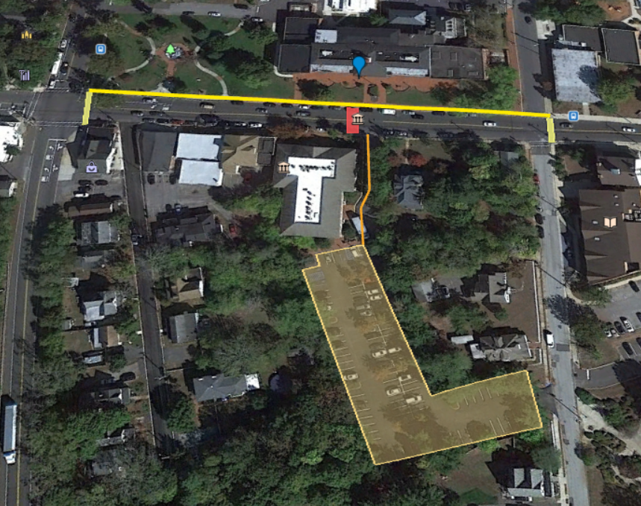
Stop 2: Atlantic County Court House @ Main St
Existing Conditions:
People cross frequently to court house from parking
Issues:
No crosswalk
No delineation for parking
Recommendations:
Mid-block crosswalk, rectangular rapid flashing beacon, in-street sign, bump outs with on-street parking
Striping for shoulder/ parking

Slide 10
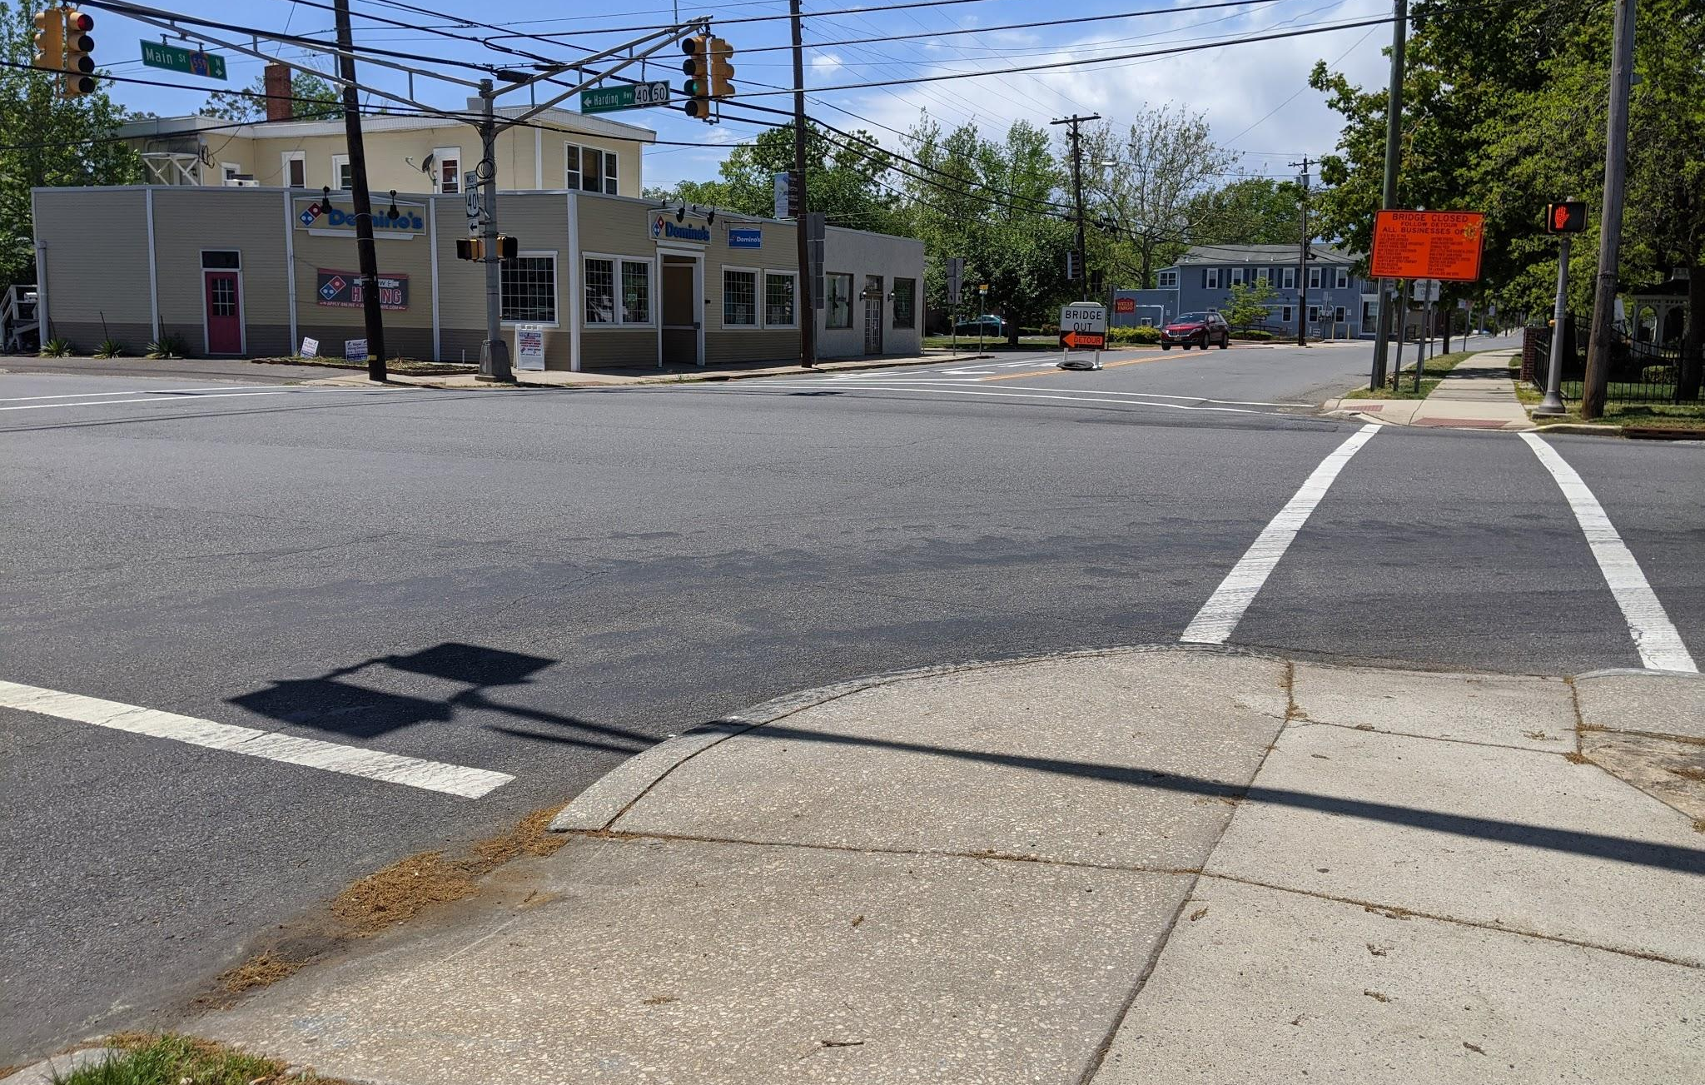
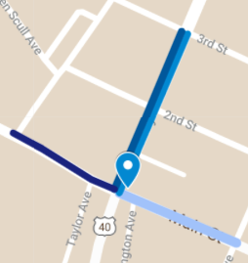
"I've been in the middle of that crosswalk and people turning left just blast through it"
Stop 3: Main St & Cape May Ave
Existing Conditions:
Right-turn traffic high frequency
Crash history
Issues:
People don’t stop for pedestrians
Curbs not ADA compliant
Recommendations:
No turn on red during certain hours, higher crosswalk visibility, lead pedestrian interval

Slide 11
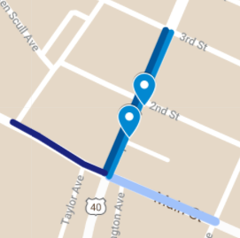
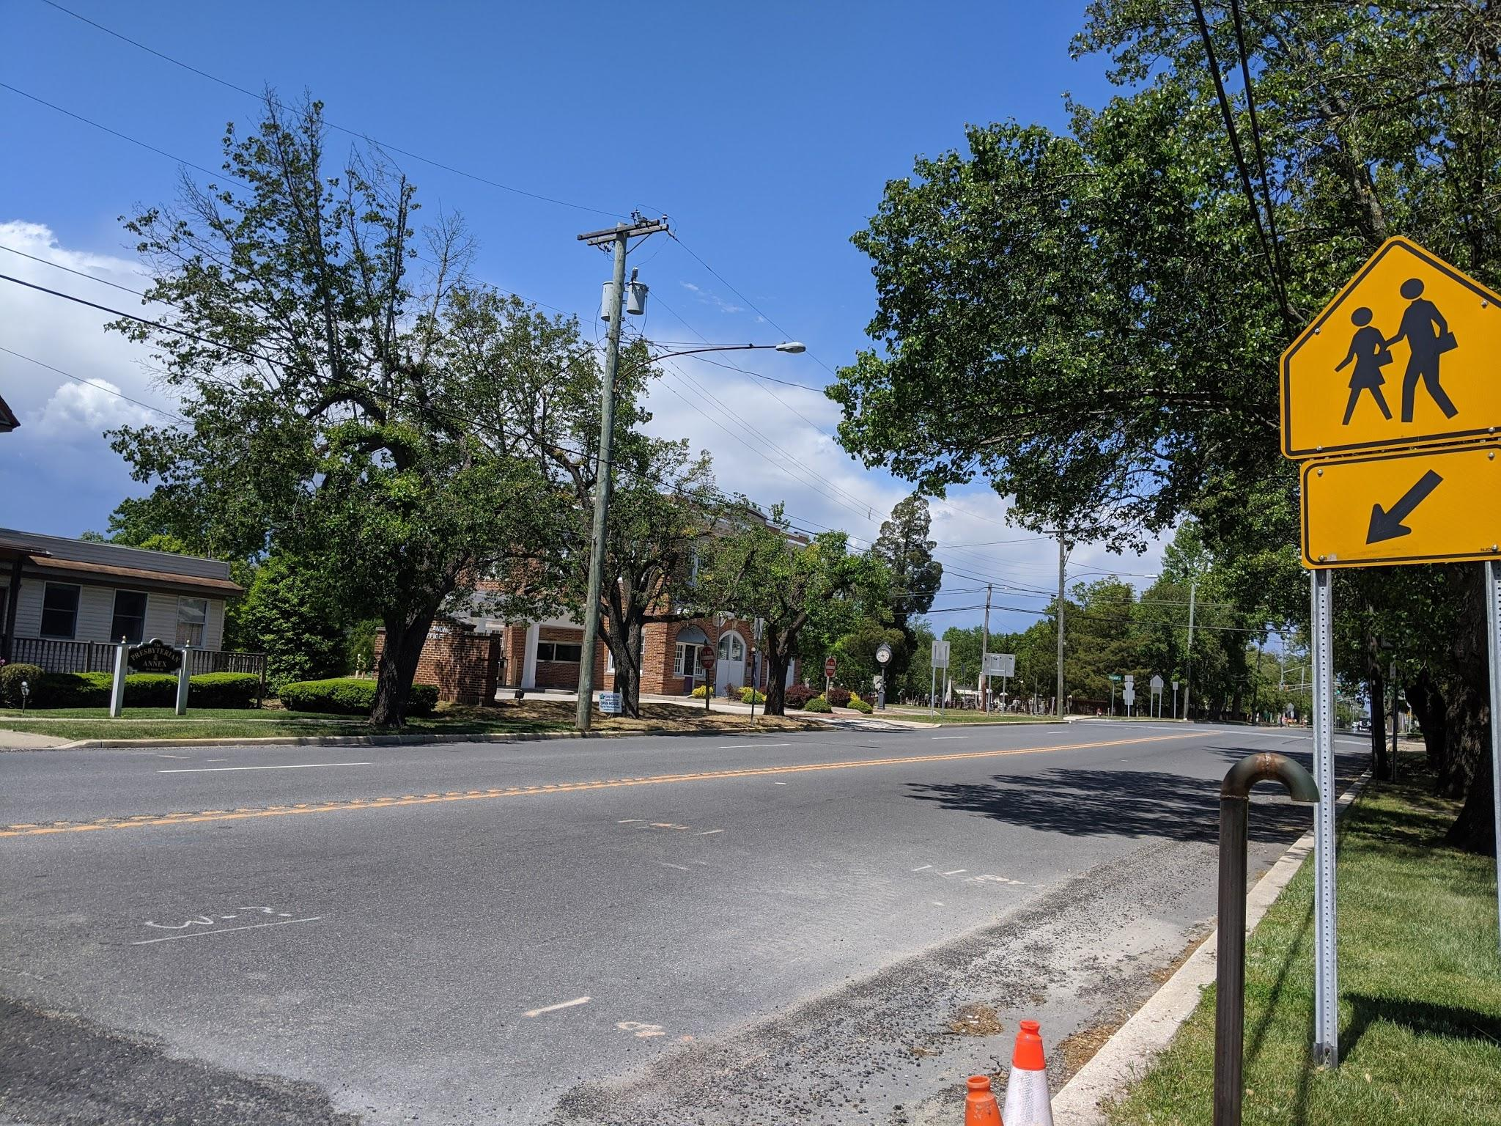
Stop 4: Cape May Ave & Parson’s Row / 2nd St
Existing Conditions:
All curb ramps are ADA compliant @ 2nd St
Issues:
Bushes encroaching onto sidewalk
Pedestrian crossing sign bottom
2nd st has only 1 crosswalk and no sign
Recommendations:
Trim bushes
Change the sign bottom to “AHEAD”

Slide 12
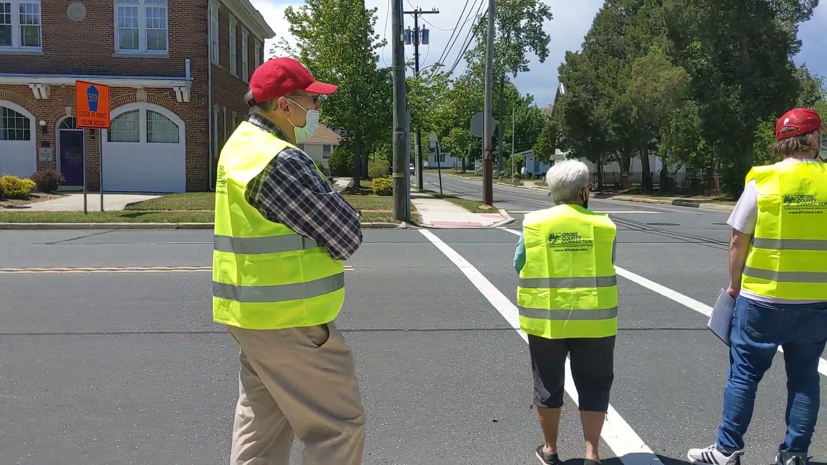
Crosswalk Test

Slide 13
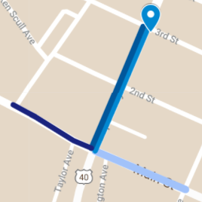
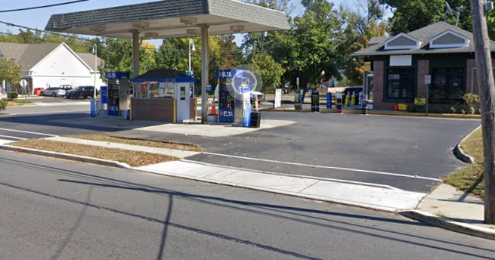
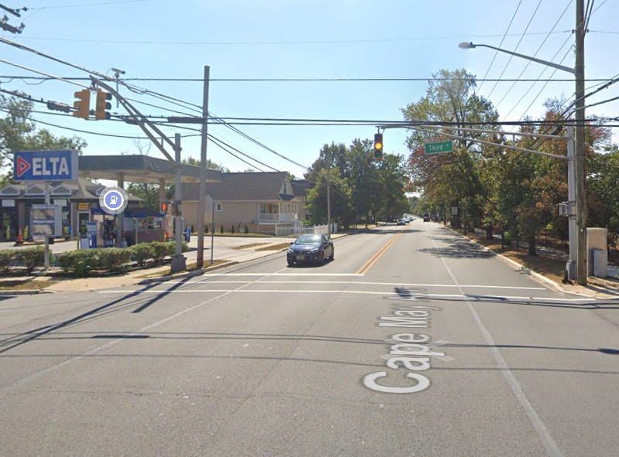
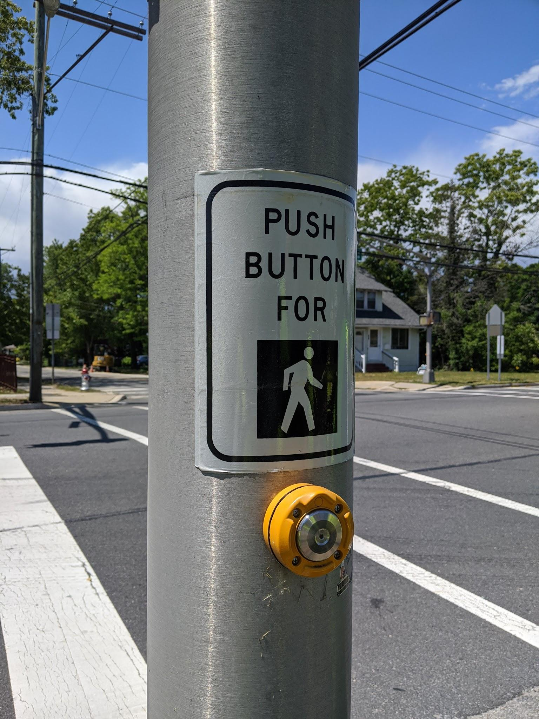
Stop 5:
Cape May Ave & 3rd St
Existing Conditions
Weird sidewalk shift*
Pedestrian signals on all corners
During high traffic periods, drivers split into 2 ln to get ready for lanes up ahead
Issues:
Bushes encroach onto the sidewalk
Only 1 button to push, no arrow
Context doesn't change with speed limit
Recommendations:
Trim bushes
Add arrow or more buttons
Lane diet, landscaping
Notes:
Not sure if bike lanes would be possible

Slide 14
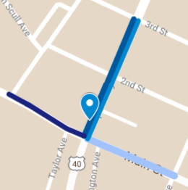
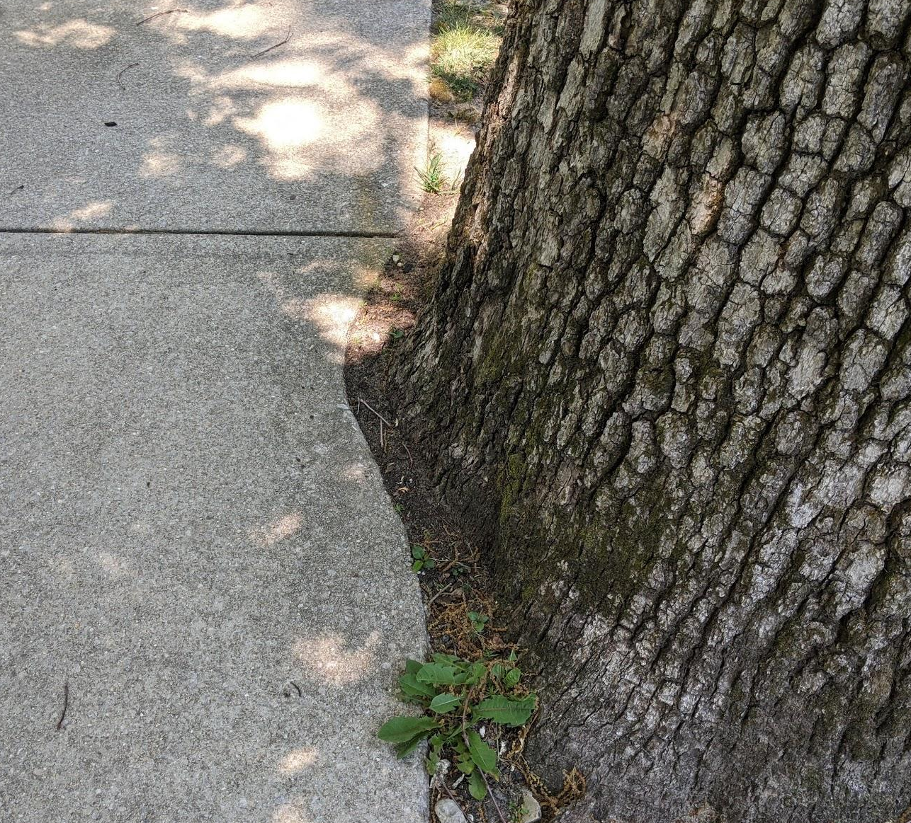
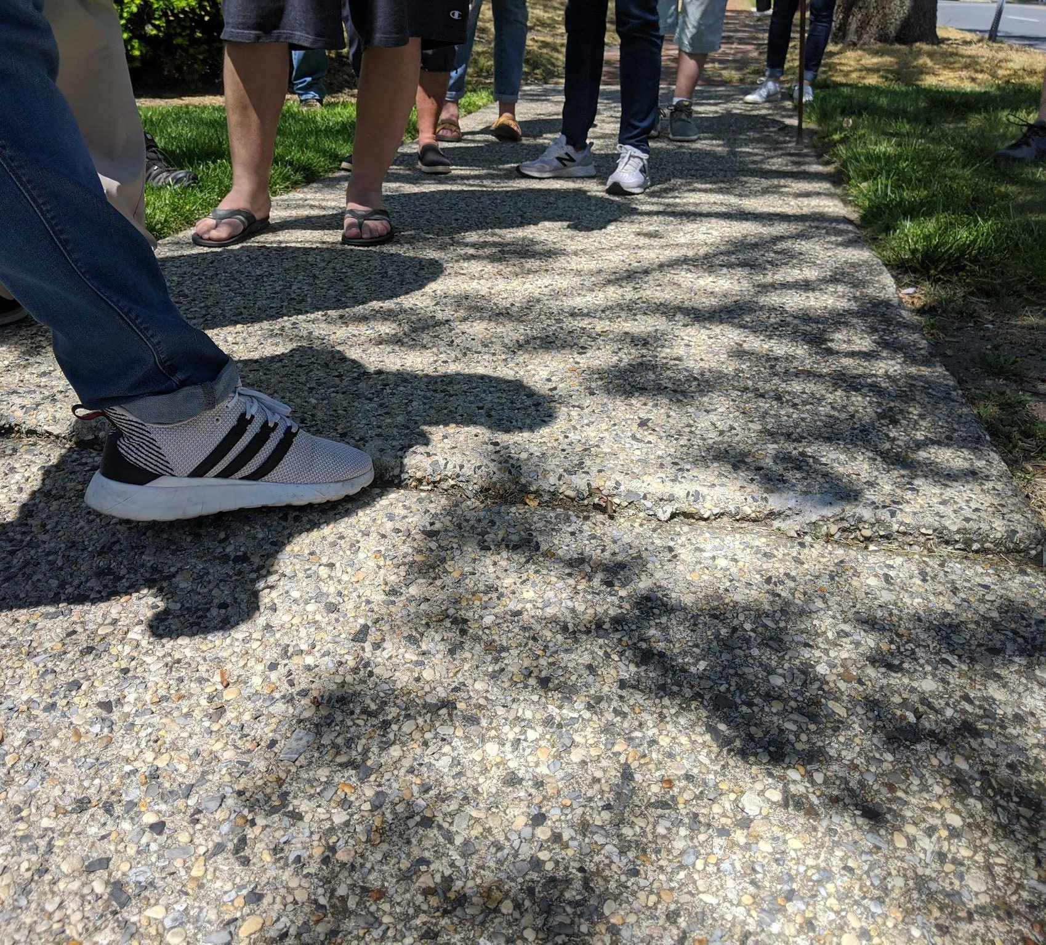
Presbyterian Church @ Cape May Ave
Stop 6
Existing Conditions:
Trees against the sidewalk
Good example of cut around for tree nearby
Issues:
Sidewalk edge raised because of tree root
Tripping hazard
Recommendations:
Cut around the tree
Fix the raised edge

Slide 15
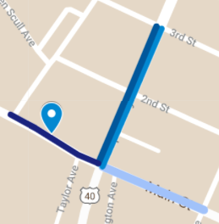
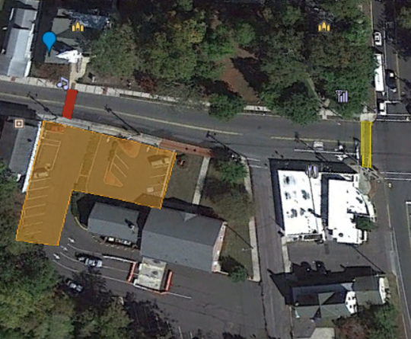
Stop 7: First United Methodist Church @ Main St
Existing Conditions:
People cross from bank parking lot to church
Road narrows
Issues:
No nearby crosswalk
Non ADA compliant curb ramp
Drivers speeding
Recommendations:
Mid-block crosswalk, rectangular rapid flashing beacon

Slide 16
Summary
Main St = County Route 559
In-street yield signs
Intersection: no turn on red during certain hours, lead pedestrian interval
Lane diets
Striping for shoulders/parking
Higher visibility crosswalks
Mid-block crosswalks
Cape May Ave = NJ Route 50
Trim bushes
Advanced warning signs
Alter pedestrian buttons at intersection
Lane diet, landscaping
Cut sidewalk around the tree
Fix the raised edge
Higher visibility crosswalk

Slide 17
Main takeaways
Higher visibility: crosswalks & pedestrians
Wide roads: speeding, lane diet + bike lanes?
Yielding: driver education
Inconsistent crosswalks/intersection designs: crosswalks, ADA

