Slide 1


Executive Summary of Rapid Public Health Assessment
Presentation to the
Hillsborough Township
Board of Health
November 14, 2023
Hillsborough Community Outreach Team
Siobhan Spano, MS, HO, Health Officer
Mary Caputo, RN, MSN
Tiffany Neal, MPH, MCHES
Amado Pacheco, MPH, CHES
Robin Vlamis, MPH, CHES
Alana Wojciechowski

Slide 2



Background
Grant Funding
  December 2020 - June 2021
    Strengthening Local Public Health Capacity
    (NJDOH pass-through from CDC)
  July 2021 – June 2022
    Strengthening Local Public Health
    Vaccination Supplemental Funding Grant
  July 2022 – June 2023
    Strengthening Local Public Health
    Vaccination Supplemental Funding Grant
  July 2023 – June 2024
    Strengthening Local Public Health
      Includes social determinants of health

Slide 3

Updated Rapid Public Health Assessment
Timing: Conducted from April-September 2023
Focus: COVID-19, flu, RSV, tickborne disease,
and other local health disparities for future planning
Partners: Hillsborough Health Collaborative members
Goals:
  Define and categorize populations disproportionately affected;
  Detail the community demographics;
  Describe health disparities and community impacts of COVID-19, flu, RSV,
  and tickborne disease;
  List community agencies that provide support to these priority populations; and
  Summarize key findings and priorities.

Slide 4

Updated Rapid Public Health Assessment
Methods:
  Reviewed secondary data sources
  Distributed and analyzed community health and wellness survey
  Conducted interviews and focus groups with key stakeholders, community informants, and priority populations
  Analyzed quantitative and qualitative data
  Solicited feedback from Hillsborough Health Collaborative members
  Updated findings and recommendations

Slide 5






Priority Populations
Economic Disadvantage
People with low-income or limited assets, low-wage workers with multiple jobs, solo caregivers
Age Groups
Senior citizens; infants and children; parents and guardians of young children or children with health conditions
People Living in Congregate or Sub-Standard Living Situations
People living in long-term care facilities, group homes, or temporary housing
Difficulty Accessing Information or Technology
People with low literacy, people with limited English proficiency, immigrants and refugees
Isolation (Cultural, Geographic, or Social)
People without reliable transportation, people living alone, people who are homebound, people with mental illness, people in stigmatized groups (e.g. LGBTQ, racial/ethnic minorities, disabled)
Census Tracts
● Census tract 053805 (northeastern part of town bordering Manville and Millstone)
● Census tract 053705 (west of 206 between New Amwell and Amwell)

Slide 6





Priority Populations (cont’d)
People with Certain Health Conditions
People who are hospitalized, people living with chronic health conditions, people living with mental illness or substance use, people with disabilities
Challenges with Accessing Healthcare
People who are uninsured or underinsured; people who avoid seeking care due to cost, access, or stigma
Individuals at High Risk for Severe Illness from COVID-19
Senior citizens, pregnant women, and people with underlying health conditions or who are immunocompromised
Individuals at High Risk for Infection with COVID-19
Frontline essential workers, healthcare personnel, emergency responders, school and childcare workers
Long-Term Care Residents and Staff
● Skilled nursing/rehab facilities
● Assisted living facilities
● Group homes

Slide 7
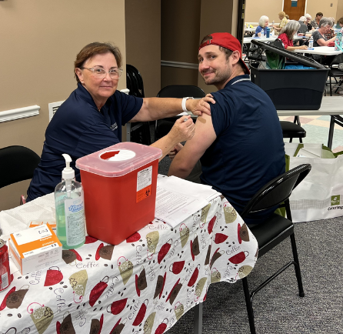
Respiratory illnesses (COVID, flu, & RSV)
Health Impact
  COVID, flu, and RSV can cause mild to severe illness, and at times can lead to death.
  Anyone can get severe illness, but some people are at higher risk.
Populations Especially Affected
  Senior citizens (COVID, flu, RSV)
  Babies and children younger than 5 (flu, RSV)
  Pregnant women (COVID, flu)
  People of any age with underlying health conditions or who are immunocompromised (COVID, flu, RSV)
Action Plan
  Host flu/COVID vaccine clinics (~2 per month), share information about where to get the RSV vaccine, and coordinate vaccines for homebound residents.
  Offer infection control training at long-term care facilities.
  Distribute prevention messages through various channels, including Hillsborough Health Collaborative partners, the weekly Mayor’s e-newsletter, the HTPS school district newsletter, Facebook, digital display board in the Municipal Building, and community events such as the Rotary Fair.
  Distribute COVID test kits to populations who may have trouble accessing them.

Slide 8
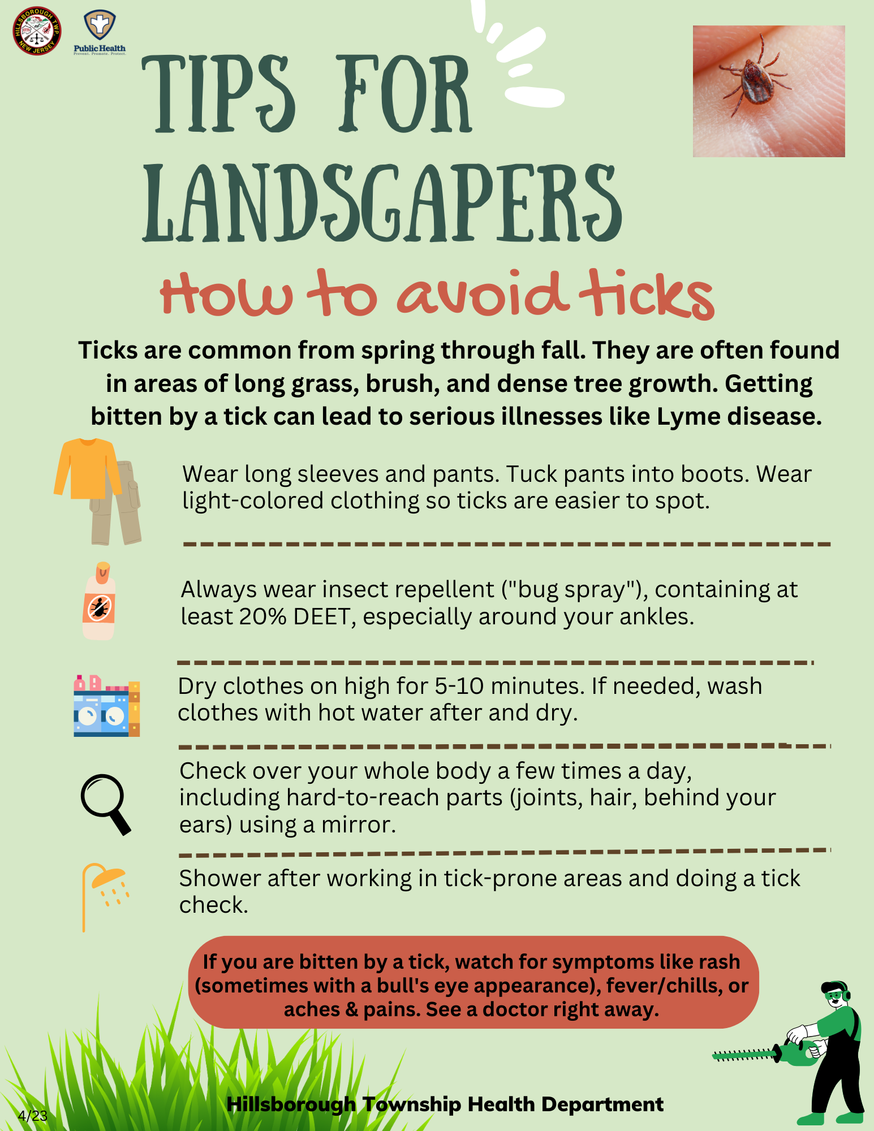
Tickborne Disease
Health Impact
  Lyme disease is the most common tickborne disease. In 2021, NJ had the most cases of lyme disease in the U.S., and the third highest rate by population.
  If left untreated, lyme disease can spread to joints, the heart, and the nervous system.
  In addition to the human health impact, tickborne diseases pose a serious health threat to dogs and cats.
Populations Especially Affected
  Adults and children who spend time outdoors – working, hiking, or playing in grassy or wooded environments.
  In Somerset County, ticks are active year-round, with the greatest risk of spreading disease in the spring and early summer.
Action Plan
  Update the health department website with information on preventing tick bites, removing ticks, and other tick-related resources.
  Post tick prevention signs at outdoor spots where ticks are common (e.g. walking paths).
  Distribute prevention messages through various channels, including Hillsborough Health Collaborative partners, the weekly Mayor’s e-newsletter, the HTPS school district newsletter, Facebook, digital display board in the Municipal Building, and community events such as the Rotary Fair.

Slide 9

Overall Action Plan
Improve access to testing, vaccines, and disease monitoring
  Distribute COVID test kits
  Distribute information about local testing and vaccine access
  Coordinate vaccine access through clinics and homebound visits
  Use CDRSS database for infectious disease monitoring and investigation
Community outreach
  Update resource directory and promote linkages to primary care and support services
  (e.g. childcare, SNAP)
  Distribute health education materials through diverse channels
  Table at community events (e.g. Rotary Fair, Green Living and Wellness Fair)
  Improve communication about existing resources and services
Partnerships with local stakeholders
  Facilitate monthly Hillsborough Health Collaborative meetings
  Partner with library to offer and promote more ESL classes

Slide 10
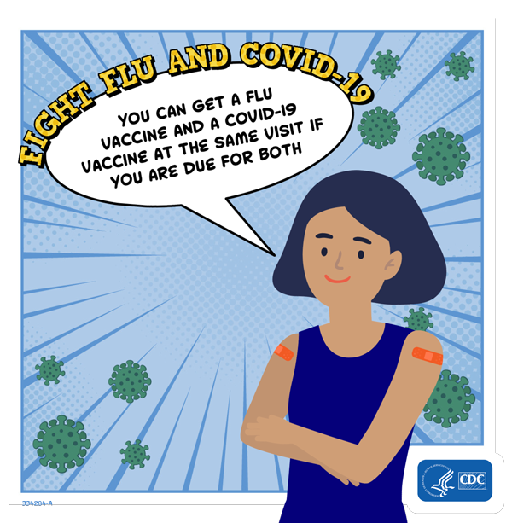
Thank you!
Questions? Please contact:
Hillsborough Community Outreach Team
908-369-5652
healthcollaborative@hillsborough-nj.org

